Slide 1
Buoyancy

Slide 2
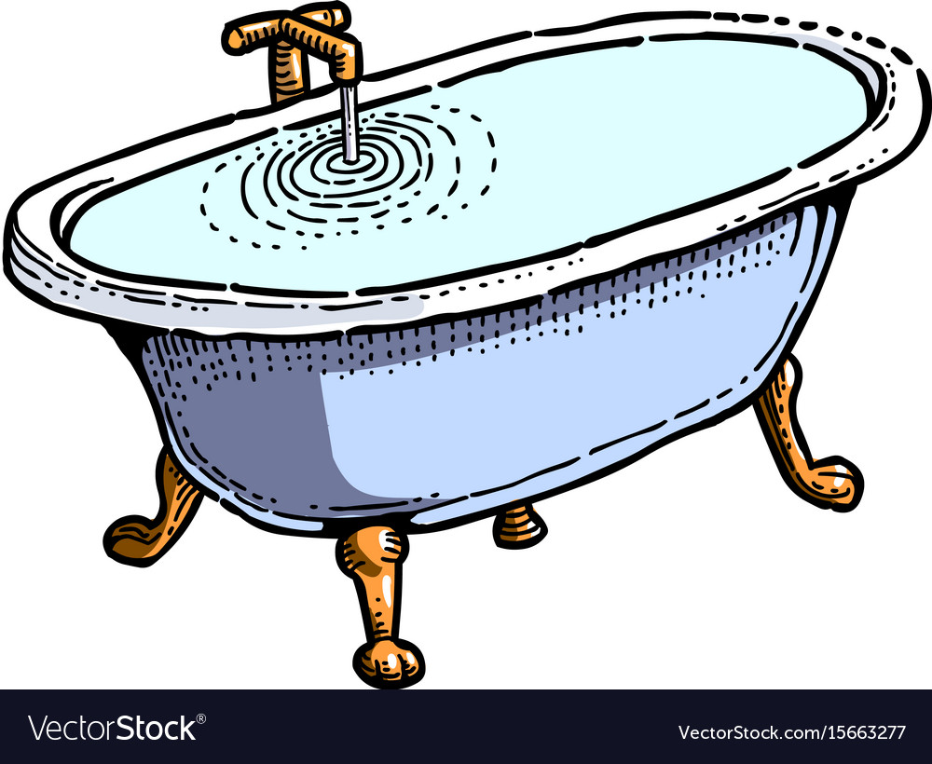
Water Displacement
What happens when you get into a full bathtub?
Notes:
It overflows, and that water that spilt over is called

Slide 3
Water Displacement
The water overflows!
The water that overflows has been displaced from the bathtub.
The weight of this displaced water is what determines if something will float
Notes:
It overflows, and that water that spilt over is called

Slide 4
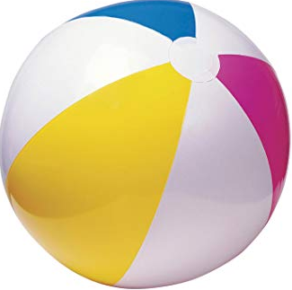
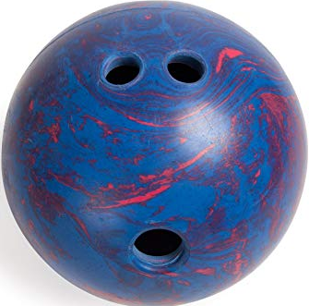
Density
Say you have a Bowling ball and beach ball that are the same size, they should displace the same amount of water...right?
But it turns out they don’t, because the beach ball will float!

Slide 5
Density
Since the bowling ball sunk, it displaces this much water
Since the beach ball floats, it only displaces this much water.

Slide 6
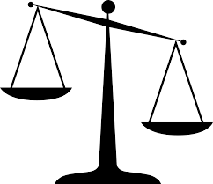
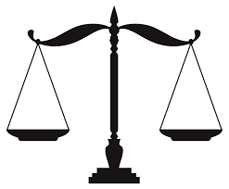
Density
The Bowling ball is heavier than the water that it displaced so it sinks.
The beach ball is lighter than the water it displaced so it floats.
The weight of water is what makes things float!

Slide 7
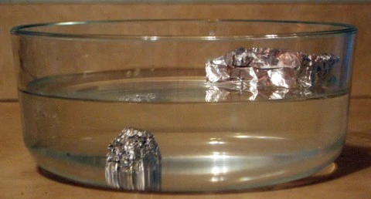
Surface Area
So now we have two pieces of aluminum that weigh the same.
Why did the aluminum ball sink, when the flat aluminum floats?

Slide 8
Surface Area
One piece of aluminum has more area for the water to push up on, which is why it floats.
If something is Buoyant the water is pushing up harder than the object is being pushed down.

Slide 9
So… how is this boat floating?

Slide 10
The big surface area distributes the heavy weight

Slide 11
So the weight of the boat is equal to the weight of the water it displaced

