Slide 1
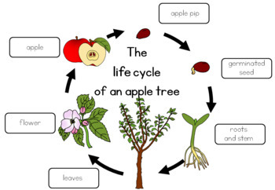

Slide 2
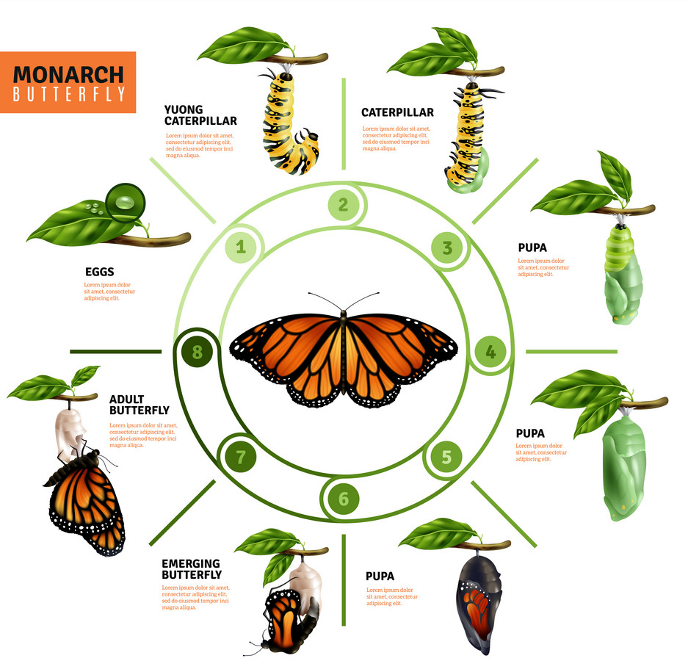

Slide 3
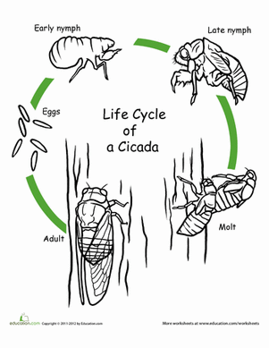

Slide 4
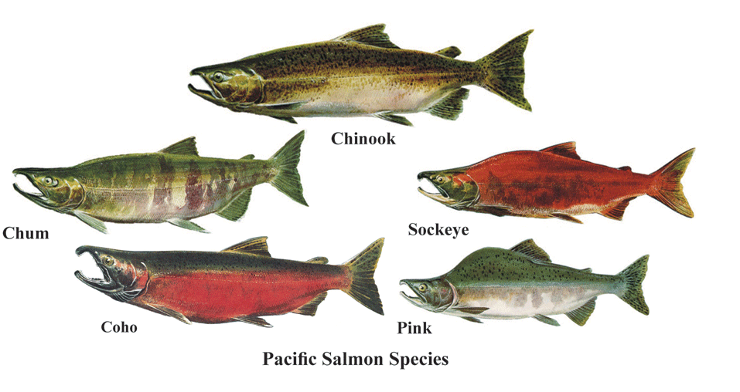
Pacific Salmon

Slide 5
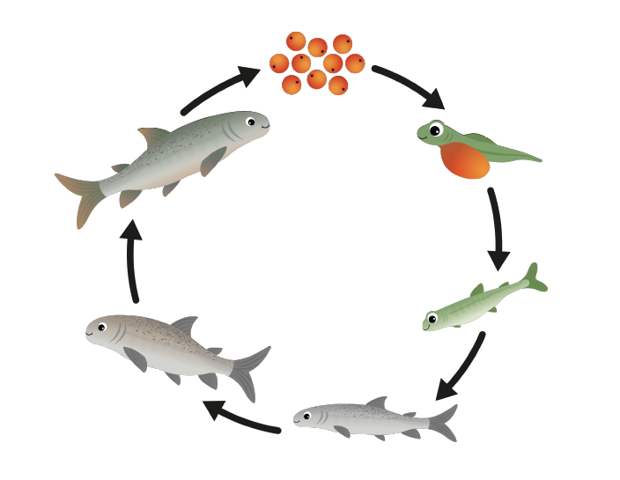
Eggs
Habitat: freshwater stream/ river
Alevin
Habitat: freshwater stream/ river
Spawners
Habitat: freshwater stream/ river
A salmon nest is called a redd
Alevin get nutrients from their Yolk sacs
Salmon lay up to 3,000 eggs
Fry
Habitat: freshwater stream/ river
Adult
Habitat: Ocean
Salmon live in the ocean for 2-8 years
Begin their journey down stream
Smolt
Habitat: Estuary
A Smolt lives in an estuary to get used to salt water

