Slide 1
Life Cycles and Watersheds
Tri-State Steelheaders

Slide 2
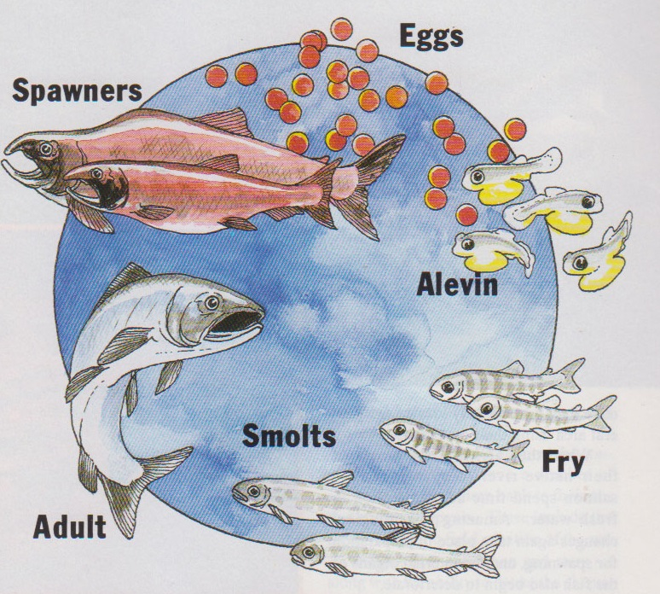

Slide 3
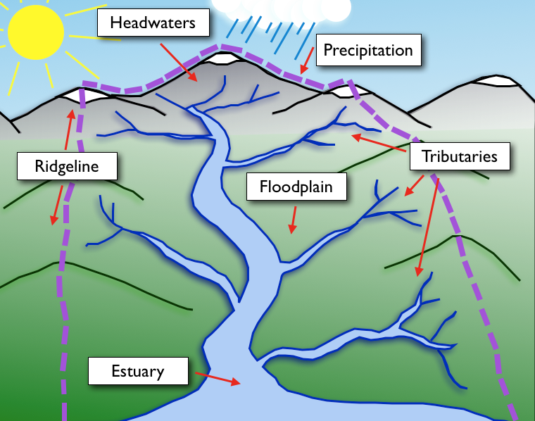
Salmon Habitat
Ocean

Slide 4
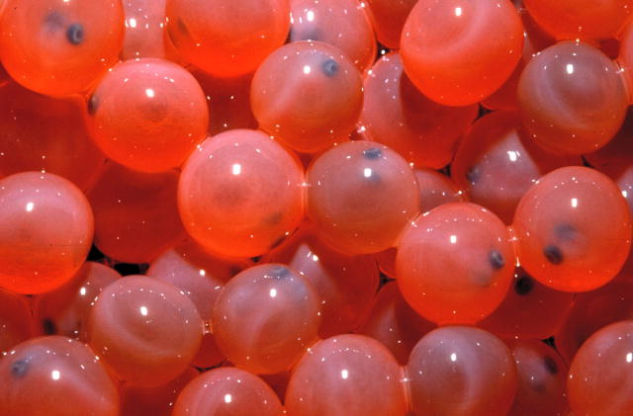
Salmon Habitat
Eggs
Ocean

Slide 5
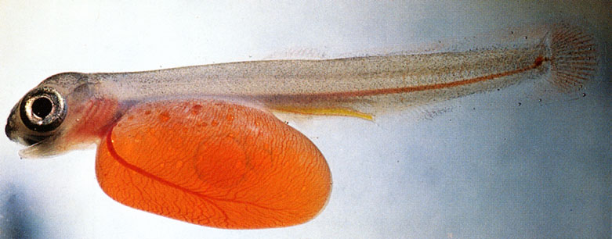
Salmon Habitat
Alevin
Ocean

Slide 6
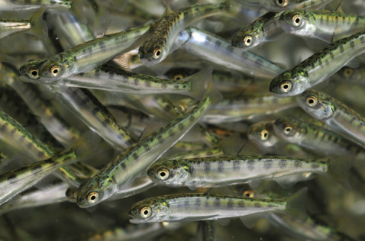
Salmon Habitat
Fry
Ocean

Slide 7
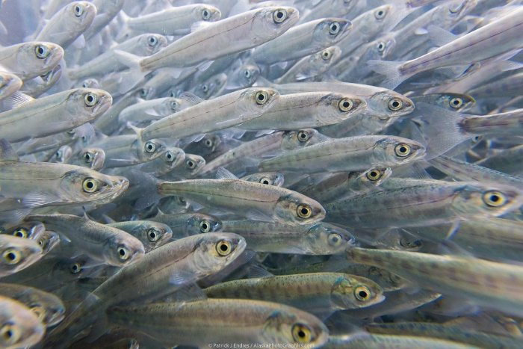
Salmon Habitat
Smolt
Ocean

Slide 8
Salmon Habitat
Adult
Ocean

Slide 9
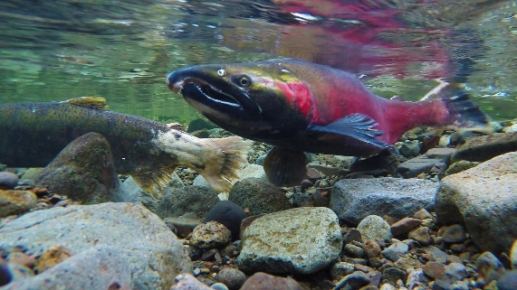
Salmon Habitat
Spawner
Ocean

Slide 10
Watershed
An area of land drained by a river and its tributaries to a common outlet. The outlet may be a closed basin, a larger stream, a lake, wetland, estuary or ocean
Within its boundaries, a watershed includes all of the land, air, surface and groundwater, plants and animals, mountains, deserts, cities, farms and people within it

Slide 11
Mainstem

Slide 12
Mainstem
Primary Tributaries

Slide 13
Mainstem
Primary Tributaries
Secondary Tributaries

Slide 14
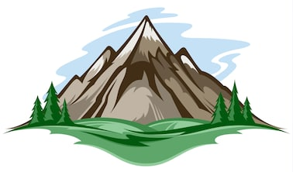
The Boundary of a watershed is the Ridgeline

Slide 15
Watershed
Ocean

Slide 16
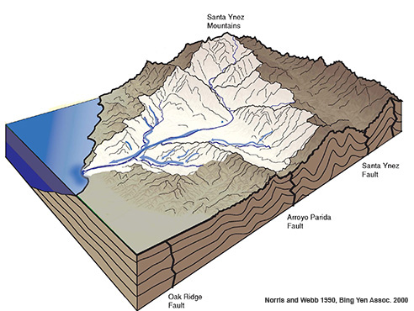

Slide 17
Where is the outline or the Ridgeline of this watershed?

Slide 19
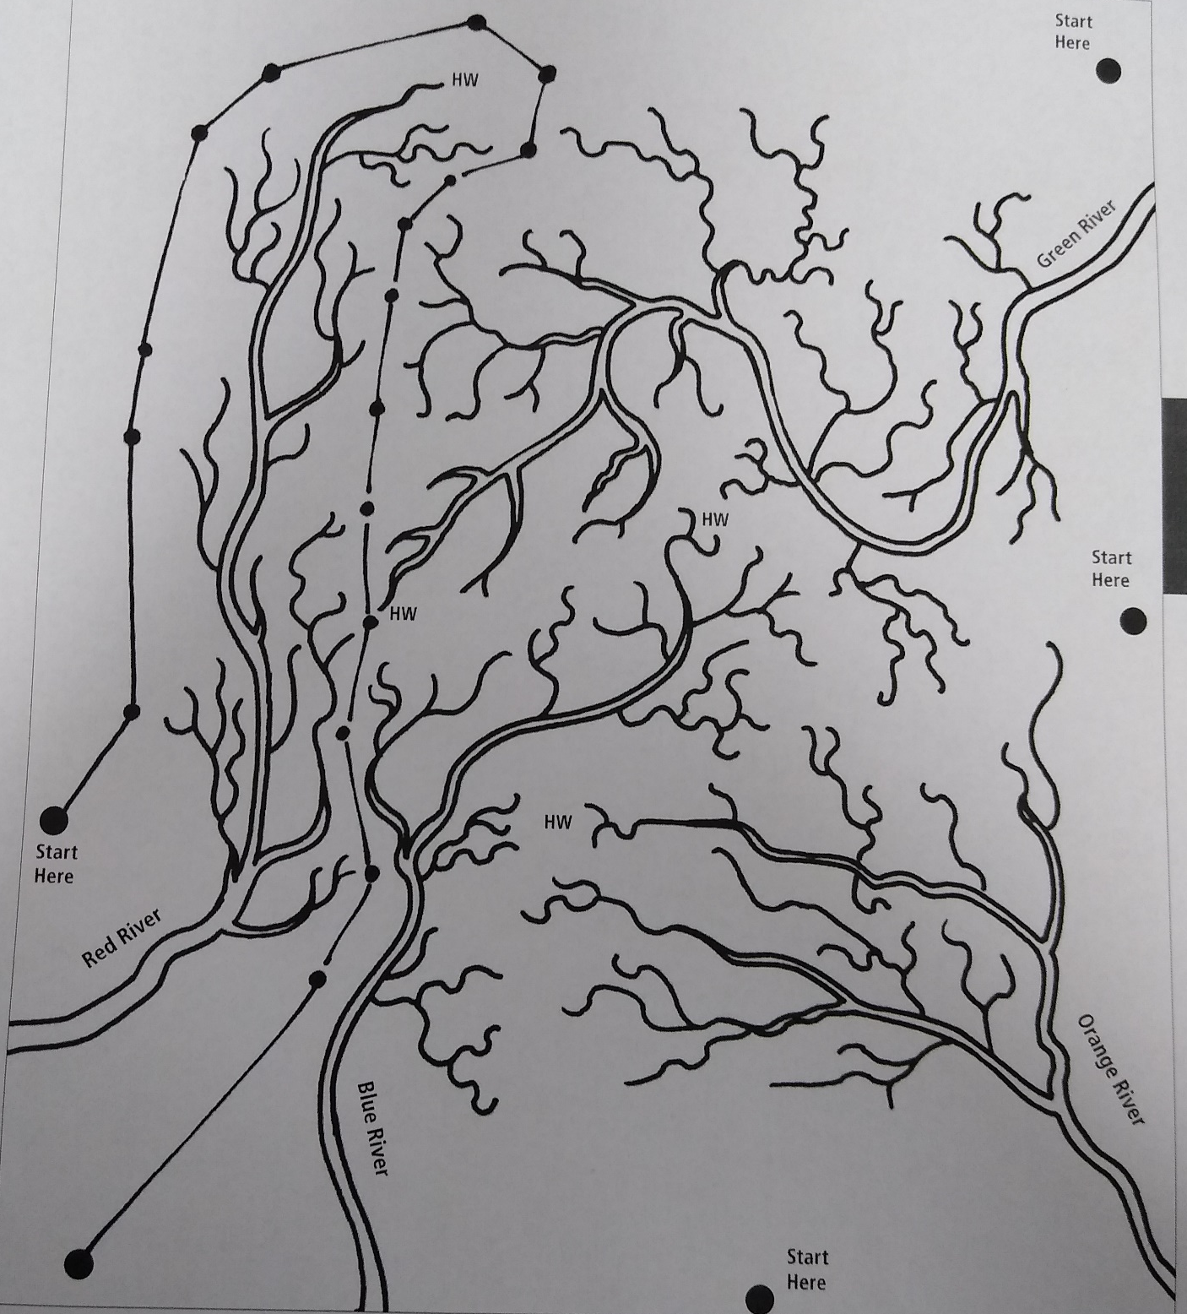

Slide 21
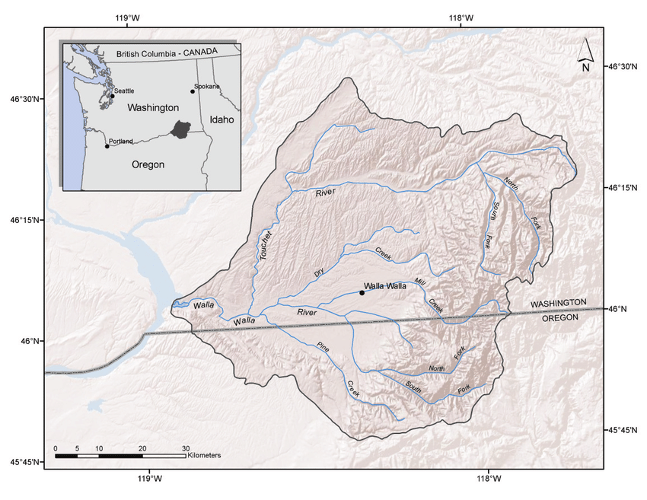

Slide 22
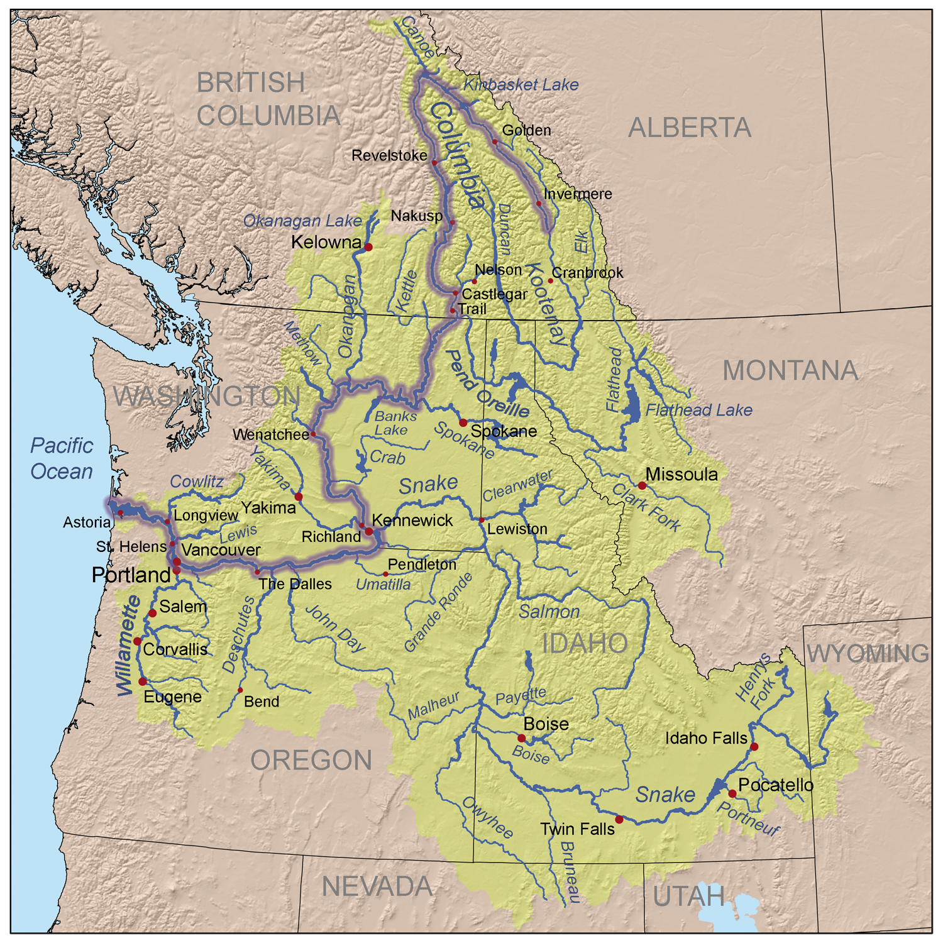

Slide 23
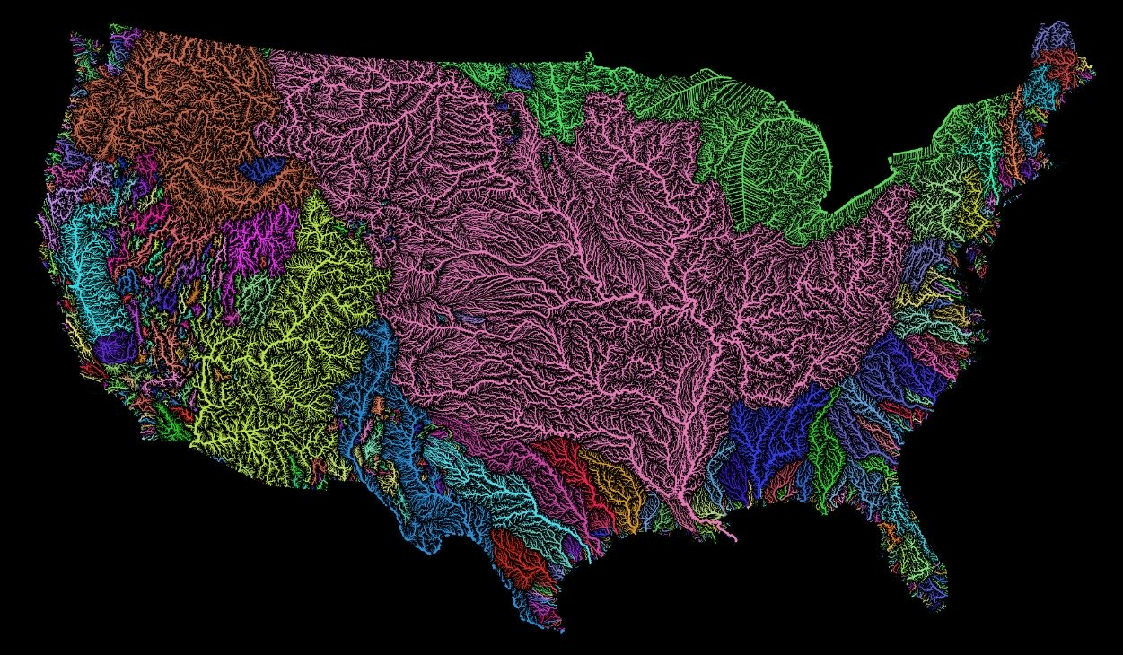

Slide 24
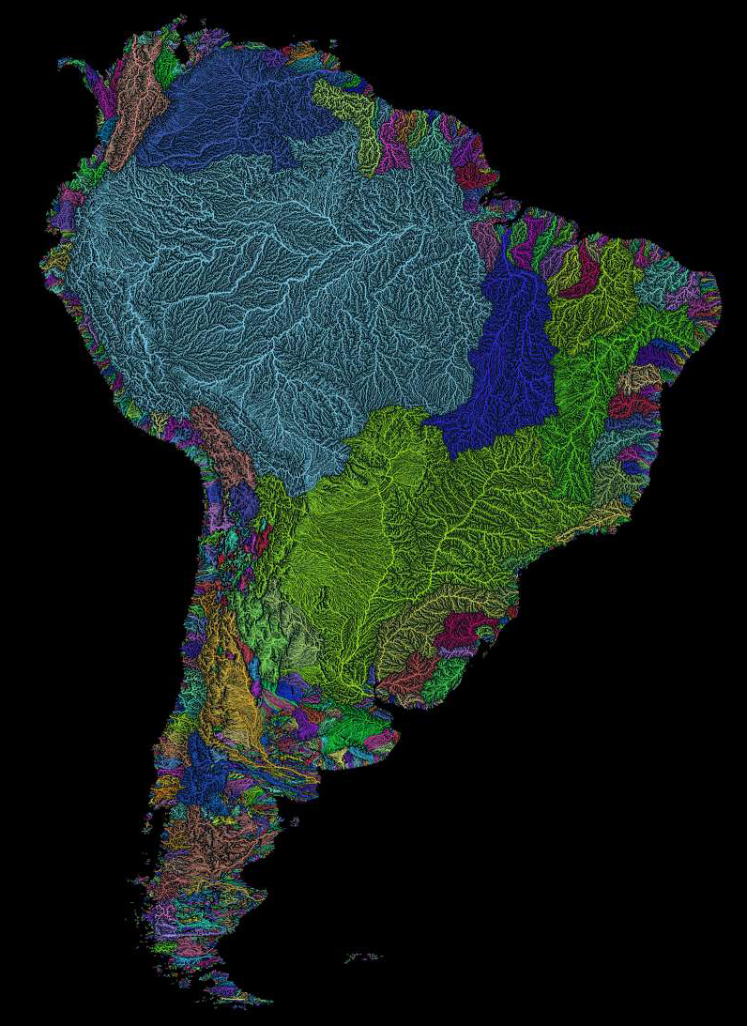

Slide 25
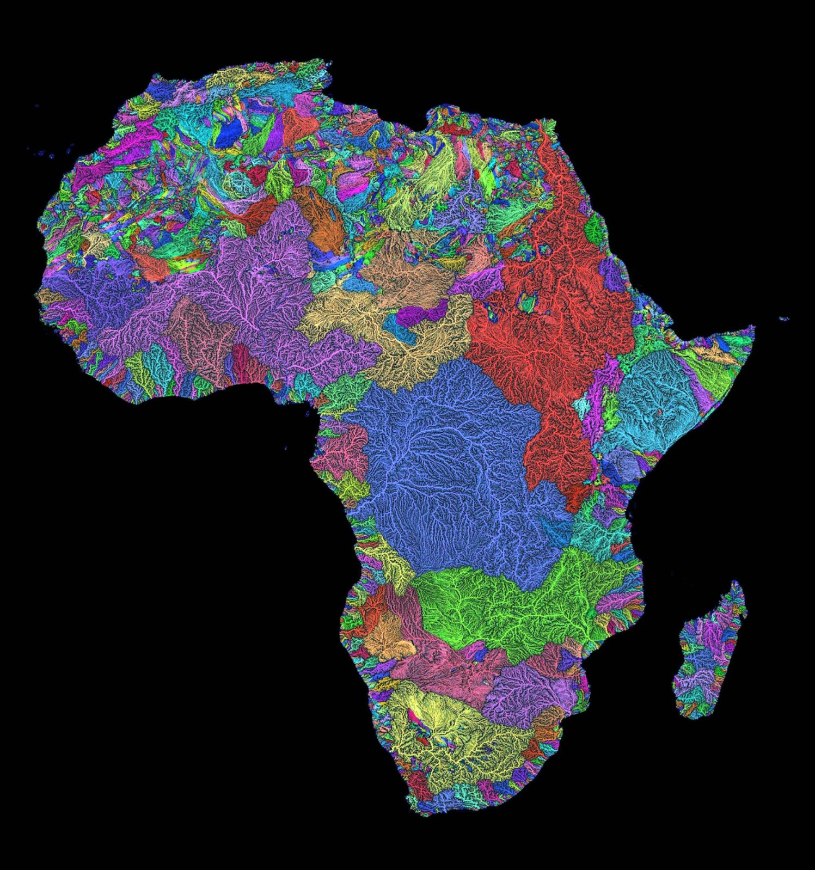

Slide 26
