Slide 1
Osmoregulation
Tri-State Steelheaders

Slide 2
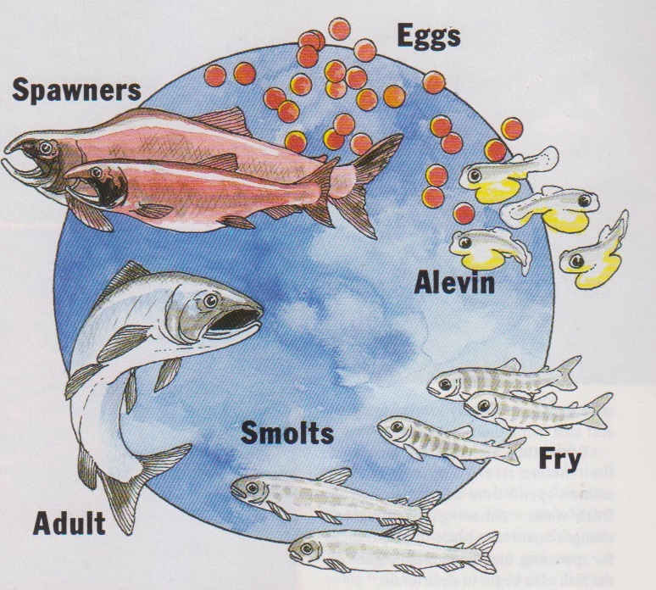
Salmon life Cycle
Salmon live in both freshwater and saltwater depending on the stage of the life cycle in which the salmon is living.
Salmon are Anadromous
Anadromous: a type of fish that hatch in streams and migrate to the ocean, then migrate back to the freshwater streams to spawn.

Slide 3
Salmon life Cycle
Salmon live in freshwater As eggs, alevin, and fry

Slide 4
Salmon life Cycle
Salmon live in an estuary As smolt
Estuary: where the freshwater river or stream meets the saltwater ocean.

Slide 5
Salmon life Cycle
Salmon live in the ocean As adults for 3 - 8 years

Slide 6
Salmon life Cycle
As spawners, Salmon transition from the ocean back to freshwater

Slide 7
Osmosis - A little Review
Osmosis: The process by which molecules of a solvent pass through a semipermeable membrane from a less concentrated solution into a more concentrated, thus equalizing the concentration on each side of the membrane.
Solutions will always go down the concentration gradient
Moving from a less concentrated solution
To a More concentrated solution

Slide 8
Osmosis - A little Review
Osmosis: The process by which molecules of a solvent pass through a semipermeable membrane from a less concentrated solution into a more concentrated, thus equalizing the concentration on each side of the membrane.
This is a cell with a Semipermeable membrane in a solution.
Semipermeable: Solvents (water) can pass through the membrane, but solutes (salt) cannot.

Slide 9
Osmosis - A little Review
The cell is placed in saltwater. The salt is higher concentration outside the cell than inside the cell. The environment is Hypertonic
Saltwater
Hypertonic: there is a higher concentration of solutes (salt) outside the cell than inside the cell

Slide 10
Osmosis - A little Review
The cell is placed in saltwater. The salt is higher concentration outside the cell than inside the cell. The environment is Hypertonic
Saltwater
These solutions will try to find equilibrium and become Isotonic
Isotonic: when the solution on either side of the membrane has the same concentration.

Slide 11
Osmosis - A little Review
The cell is placed in saltwater. The salt is higher concentration outside the cell than inside the cell. The environment is Hypertonic
The solution will try to find equilibrium and become Isotonic
Salt cannot pass through the Semipermeable membrane, only water can.
Saltwater

Slide 12
Osmosis - A little Review
The cell is placed in saltwater. The salt is higher concentration outside the cell than inside the cell. The environment is Hypertonic
Saltwater
So….. How will the solution find equilibrium?

Slide 13
Osmosis - A little Review
The cell is placed in saltwater. The salt is higher concentration outside the cell than inside the cell. The environment is Hypertonic
Saltwater
The water is going to exit the cell until the solution on either side is the same

Slide 14
Osmosis - A little Review
The cell is placed in saltwater. The salt is higher concentration outside the cell than inside the cell. The environment is Hypertonic
Saltwater
If the solution outside the cell is salty enough the cell will continue to lose water, and can result in it becoming shriveled and dehydrated!

Slide 15
Osmosis - A little Review
Solutions will always go down the concentration gradient
Moving from a less concentrated solution
The Cell
To a More concentrated solution
Saltwater

Slide 16
Osmosis - A little Review
This time…. the cell is placed in freshwater. The salt is lower concentration outside the cell than inside the cell. The environment is Hypotonic.
Freshwater
Hypotonic: there is a lower concentration of solutes (salt) outside the cell than inside the cell.

Slide 17
Osmosis - A little Review
This time…. the cell is placed in freshwater. The salt is lower concentration outside the cell than inside the cell. The environment is Hypotonic
The solution will try to find equilibrium and become Isotonic
Salt cannot pass through the Semipermeable membrane, only water can.
Freshwater

Slide 18
Osmosis - A little Review
This time…. the cell is placed in freshwater. The salt is lower concentration outside the cell than inside the cell. The environment is Hypotonic
Freshwater
So….. How will the solution find equilibrium?

Slide 19
Osmosis - A little Review
This time…. the cell is placed in freshwater. The salt is lower concentration outside the cell than inside the cell. The environment is Hypotonic
Freshwater
The water is going to enter the cell until the solution on either side is the same

Slide 20
Osmosis - A little Review
This time…. the cell is placed in freshwater. The salt is lower concentration outside the cell than inside the cell. The environment is Hypotonic
Freshwater
If the solution inside has significantly more salt than the solution outside the cell, water will continue to enter the cell, and the cell could explode

Slide 21
Osmosis - A little Review
Solutions will always go down the concentration gradient
Moving from a less concentrated solution
Freshwater
To a More concentrated solution
The Cell

Slide 22
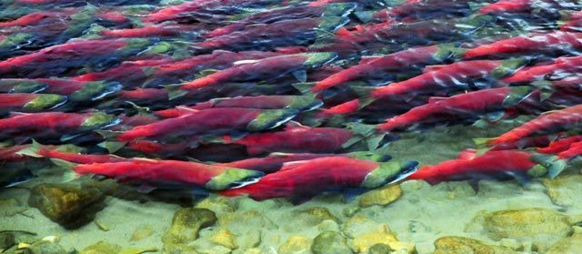
Osmosis in Salmon
Salmon need a way to regulate the intake and output of water in their cells to avoid dehydration in the ocean or… their cells exploding in the freshwater
Osmoregulation: regulation of solute concentrations and water balance by a cell or organism

Slide 23
Remember the cell in freshwater?
Water will constantly enter the cell through the membrane until the solutions reach equilibrium
Water

Slide 24
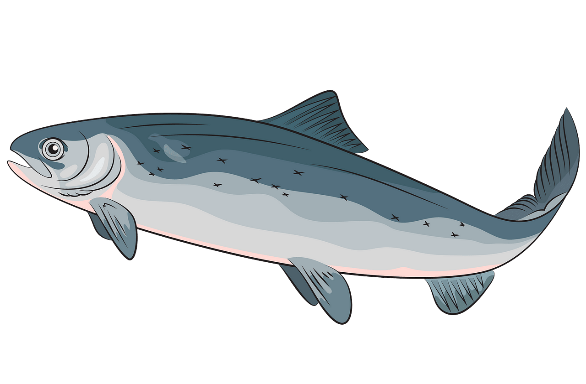
Behavioral Adaptations: Freshwater
Absorbs water through skin
Drinks less water
Diluted Urine

Slide 25
Remember the cell in saltwater?
Water will constantly leave the cell through the membrane until the solutions reach equilibrium.
Water

Slide 26
Behavioral Adaptations: Saltwater
Water loss through skin
Drinks a lot of sea water
Concentrated Urine

Slide 27
Physiological Adaptations
Salmon have cells in their gills called chloride cells, these cells help them transport salt across the membrane to maintain a healthy environment inside the fish

Slide 28
Chloride Cells in Gills
The membrane on animal cells are semipermeable. Water can flow in and out freely
Animal cells have proteins on their membranes that allow for the flow of solutes (salt) across the membrane.
These proteins work in two different ways.

Slide 29
Chloride Cells in Gills
The membrane on animal cells are semipermeable. Water can flow in and out freely
The first is Passive transport.
Passive Transport: the movement of solutes (salts) across a membrane with their concentration gradient

Slide 30
Physiological Adaptations
The membrane on animal cells are semipermeable. Water can flow in and out freely
The first is Passive transport.
Which direction will salt diffuse in saltwater?
Salt will diffuse into the cell

Slide 31
Chloride Cells in Gills
The membrane on animal cells are semipermeable. Water can flow in and out freely
The first is Passive transport.
Which direction will salt diffuse in saltwater?
Salt will diffuse into the cell
Which direction will salt diffuse in freshwater?
Salt will diffuse out of the cell

Slide 32
Chloride Cells in Gills
These proteins help the cell to become isotonic with its surroundings while keeping the correct shape.
But… now the concentration of salts inside the cell is not healthy, the internal cell cannot work properly

Slide 33
Chloride Cells in Gills
The second kind of Protein on the membrane will move solutes (salt) against their concentration gradient to maintain homeostasis inside the organism
Homeostasis: the maintenance of a steady state in the internal environment of an animal.

Slide 34
Active Transport
In order to move solutes (salt) against their concentration gradient the cell uses Active Transport
Active Transport: the use of energy (ATP) in transport proteins to move solutes against their concentration gradient.

Slide 35
Active Transport
The energy currency of a cell is called ATP
or
Adenosine
Triphosphate

Slide 36
Active Transport
To give the protein energy the ATP will break and give one Phosphate to the protein
It is now called ADP
Adenosine
Diphosphate

Slide 37
Active Transport
Because salmon exist in both fresh and saltwater they have two types of active transport proteins
One that transports salt into the cell
One that transports salt out of the cell

Slide 38
Active Transport - Freshwater
In Freshwater, the protein pumps will transport salt into the cell

Slide 39
Active Transport - Freshwater
In Freshwater, the protein pumps will transport salt into the cell
Step 1) A salt molecule will attach to the protein outside the membrane

Slide 40
Active Transport - Freshwater
In Freshwater, the protein pumps will transport salt into the cell
Step 1) A salt molecule will attach to the protein outside the membrane
Step 2) An ATP molecule will attach to the protein

Slide 41
Active Transport - Freshwater
In Freshwater, the protein pumps will transport salt into the cell
Step 1) A salt molecule will attach to the protein outside the membrane
Step 2) An ATP molecule will attach to the protein
Step 3) The ATP will break

Slide 42
Active Transport - Freshwater
In Freshwater, the protein pumps will transport salt into the cell
Step 1) A salt molecule will attach to the protein outside the membrane
Step 2) An ATP molecule will attach to the protein
Step 3) The ATP will break
Step 4) Giving the protein energy to bring the salt into the cell

Slide 43
Active Transport - Saltwater
In Saltwater, the protein pumps will transport salt out of the cell in the same way

Slide 44
Active Transport - Saltwater
In Saltwater, the protein pumps will transport salt out of the cell in the same way
Step 1) A salt molecule will attach to the protein inside the membrane

Slide 45
Active Transport - Saltwater
In Saltwater, the protein pumps will transport salt out of the cell in the same way
Step 1) A salt molecule will attach to the protein inside the membrane
Step 2) An ATP molecule will attach to the protein

Slide 46
Active Transport - Saltwater
In Saltwater, the protein pumps will transport salt out of the cell in the same way
Step 1) A salt molecule will attach to the protein inside the membrane
Step 2) An ATP molecule will attach to the protein
Step 3) The ATP will break

Slide 47
Active Transport - Saltwater
In Saltwater, the protein pumps will transport salt out of the cell in the same way
Step 1) A salt molecule will attach to the protein inside the membrane
Step 2) An ATP molecule will attach to the protein
Step 3) The ATP will break
Step 4) Giving the protein energy to bring the salt out of the cell

Slide 48
The Big Picture - Freshwater
Absorbs water through skin
Drinks less water
Active Transport Protein pumps will transport salt into the cell
Diluted Urine

Slide 49
The Big Picture - Saltwater
Water loss through skin
Drinks a lot of sea water
Active Protein pumps will transport salt out of the cell
Concentrated Urine

