Slide 1
Human Impacts on Salmon
Tri- State Steelheaders

Slide 2
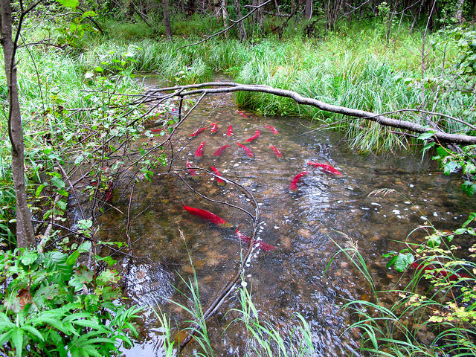
What do salmon NEED ?
Healthy Habitat!!
Cold, Clean and Clear water for spawning
Healthy river continuum
Nourishing food
Safe passage to migrate to and from the ocean

Slide 3
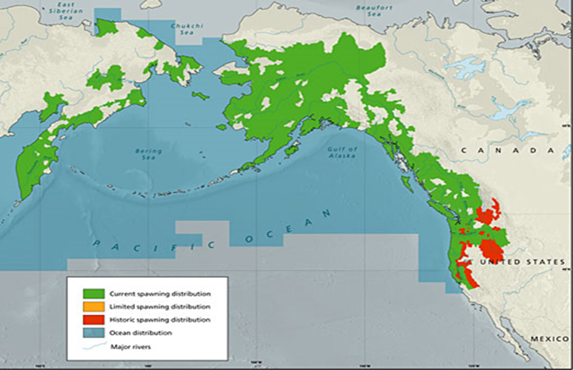
Pacific Salmon Habitat
The health of Salmon is directly dependant on the health of its habitat, or the watershed it lives in

Slide 4
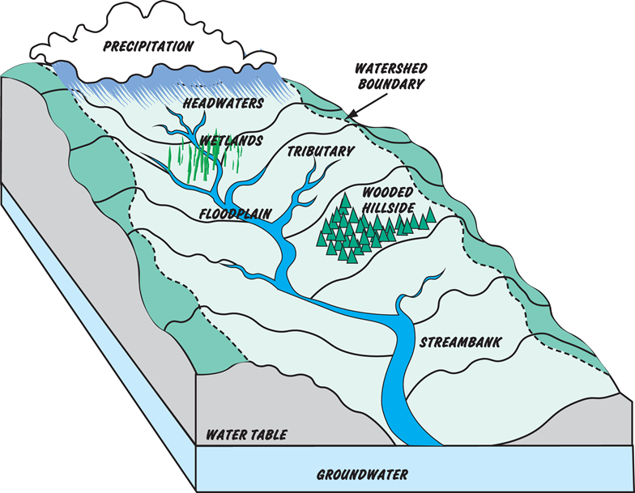
What is a Watershed?
An area of land drained by a river and its tributaries to a common outlet.
A salmon’s habitat is the entire watershed.
Salmon spawn in freshwater streams, and migrate through the watershed to the ocean.

Slide 5
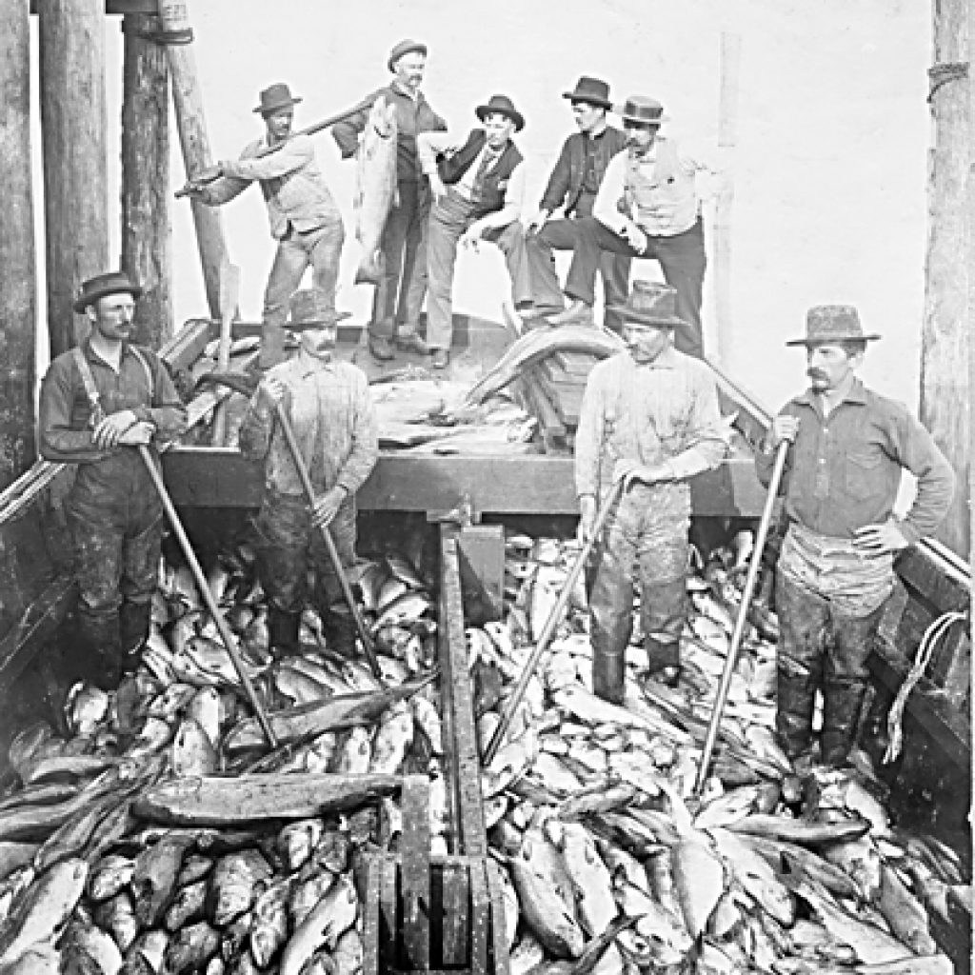
What is threatening salmon populations?
Water pollution
Blocked passage to/ from spawning grounds
Over Harvest
Habitat Destruction
Competition for and/or lack of resources

Slide 6
What is threatening salmon populations?
Water pollution
Blocked passage to/ from spawning grounds
Over Harvest
Habitat Destruction
Competition for and/or lack of resources
Name 5 causes
How could we prevent these
How can we fix it once it’s already happened

Slide 7
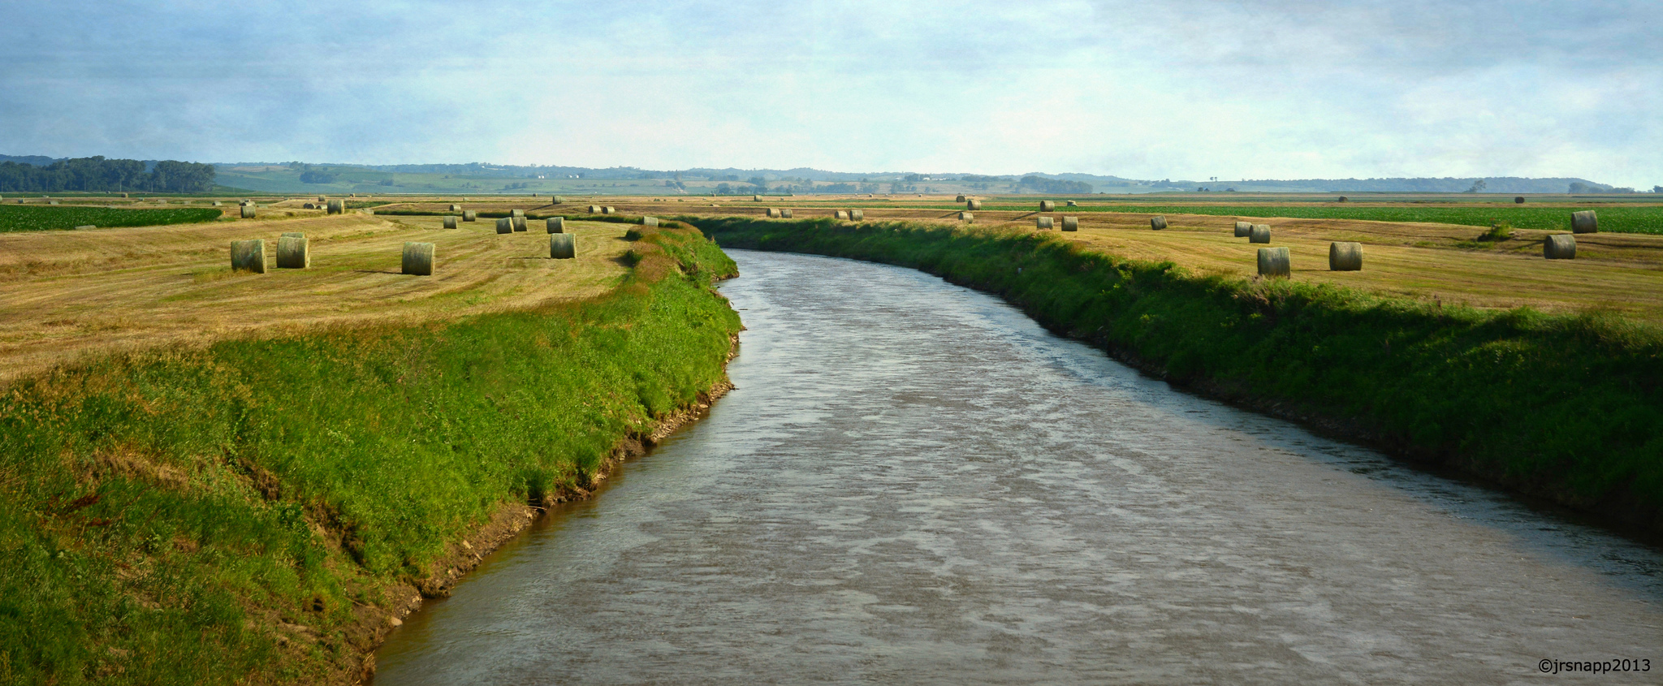
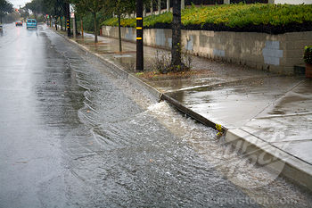
How are humans impacting water quality?
Permits and regulations are in place to control point source pollutants
Think: Factories, wastewater treatment
Nonpoint source pollutants are harder to regulate and require a change in human behavior.
Think: Agricultural runoff and urban runoff

Slide 8
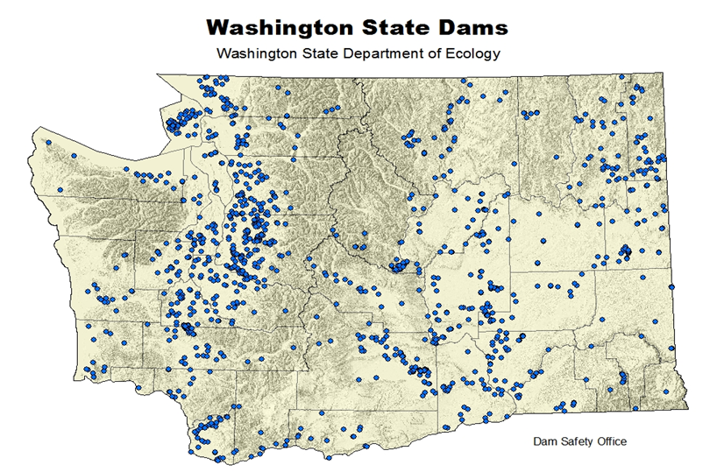
How are dams threatening salmon?
There are 1166 dams in Washington state
These dams serve as flood control, water storage, agricultural irrigation and hydro- power
How do dams affect salmon populations?

Slide 9
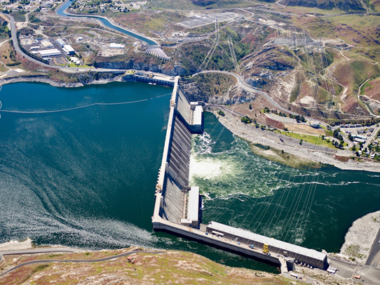
How do Dams impact salmon?
Blocks passage between spawning grounds and the ocean
Create low-flow reservoirs where fish get lost
Reservoirs have increased surface area and no canopy, causing increased temperatures
Block sediment flow through watershed
New habitat for invasive species

Slide 10
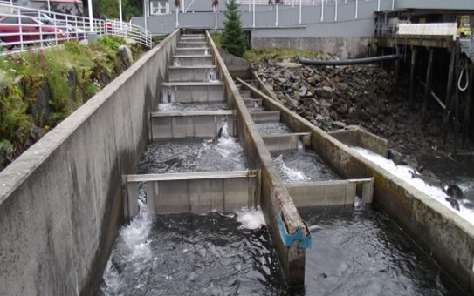
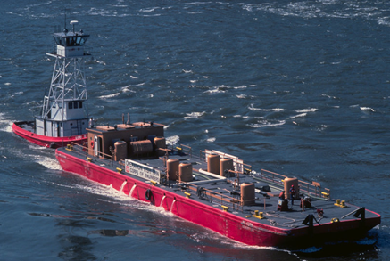
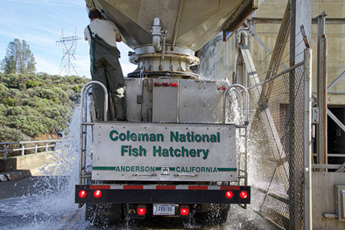
What is our solution?
Primary Focus is transporting salmon and steelhead around/ over dams.
We did this with...
Fish ladders
Barge transport
Truck Transport

Slide 11
What is our solution?
Primary Focus is transporting salmon and steelhead around/ over dams.
We did this with...

Slide 12
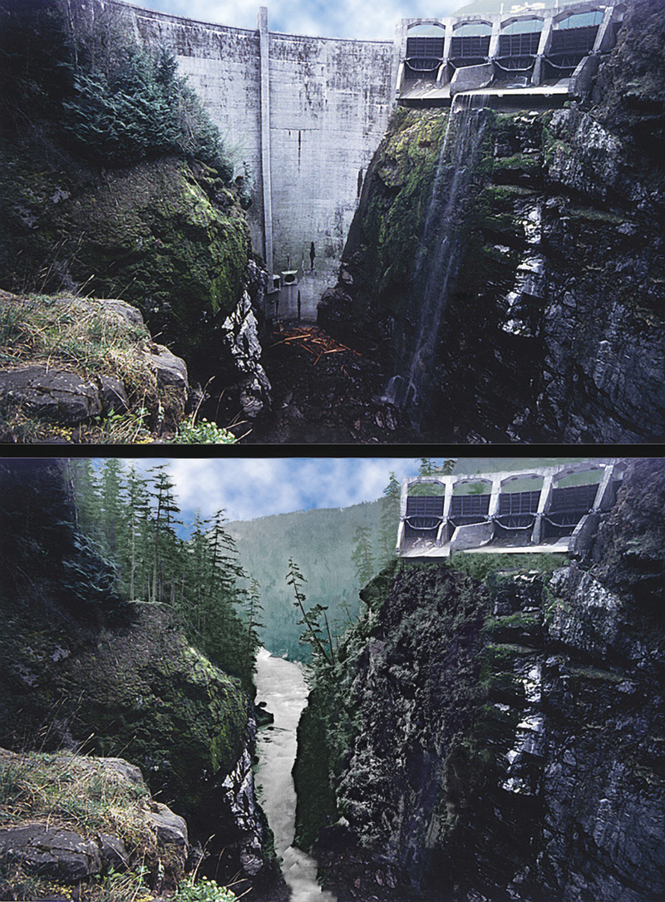
What is our solution?
Another solution is to remove dams that are no longer useful.
Two dams on the Elwha river were breached in 2011 and 2014, restoring fish passage on the Elwha River. This has brought back all species of salmon and strengthened the ecosystem.
In the last 20 years 850 dams have been removed in the state of Washington.

Slide 13
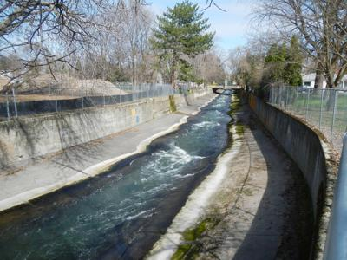
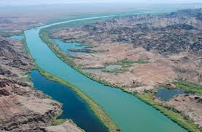
How do levees and channels impact salmon?
Unnatural habitat, disrupts the river continuum
Less vegetation cover making for warmer water
Changed velocity and variation for migrating fish

Slide 14
What is our solution?
Changing the levees and channels to attempt to mimic natural river habitats and give migratory fish the ability to pass upstream successfully

Slide 15
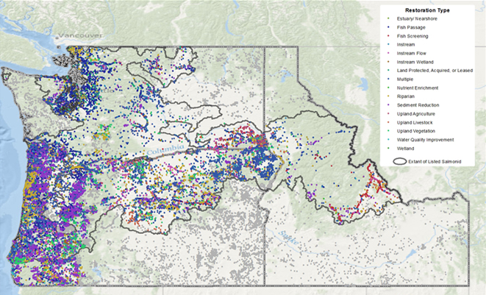
Another way we are helping salmon habitat?
There are river restoration and monitoring projects across the Pacific Northwest.

Slide 16
Another way we are helping salmon habitat?
These projects include…
Taking out passage barriers
Allowing for varied shape
Adding structure
Adding vegetation
Restoring floodplains and side channels

Slide 17
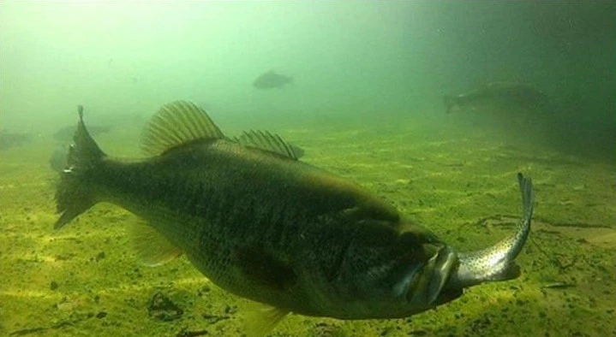
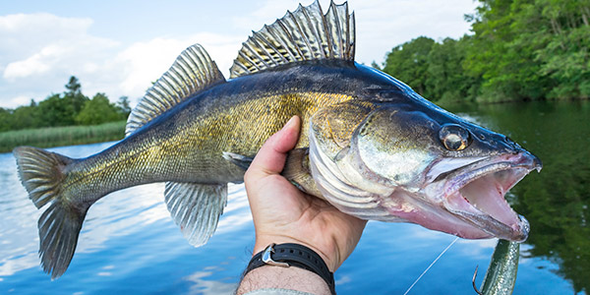
How do invasive species impact salmon?
Invasive species are species that are not native to the ecosystem, they often disrupt the balance of the ecosystem.
Salmon encounter many invasive species that are either predators or compete with them for resources. These include smallmouth bass, channel catfish, brook trout and walleye.

Slide 18
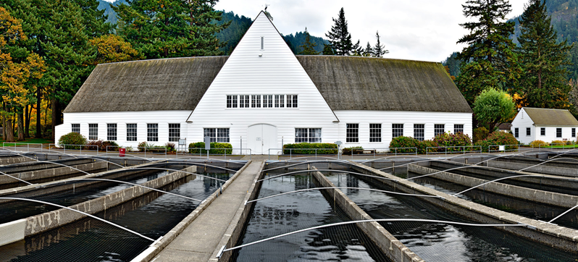
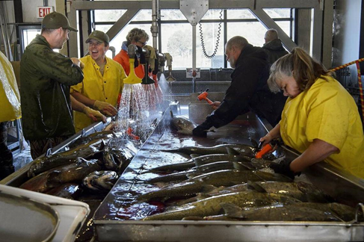
How are we increasing salmon populations?
Fish hatcheries were created to help supplement salmon population decline.
However hatchery fish outcompete wild salmon, don’t have a fear of predators (and are eaten by the thousands), breed with wild fish (ruining genetic diversity), and are human dependant

Slide 19
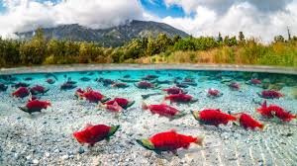
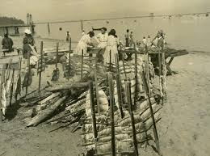
Why are salmon populations so important?
Salmon are a keystone species, making them a key part of a healthy ecosystem. They provide nutrients for everything from the predators to the trees.
Salmon are an important part of indigenous culture and health as well as a key part of the culture of the Pacific Northwest

Slide 20
What is threatening salmon populations?
Water pollution
Blocked passage to/ from spawning grounds
Over Harvest
Habitat Destruction
Competition for and/or lack of resources
Name 5 causes
How could we prevent these
How can we fix it once it’s already happened
Did you think of any of the solutions that Washington state has?

