Slide 1
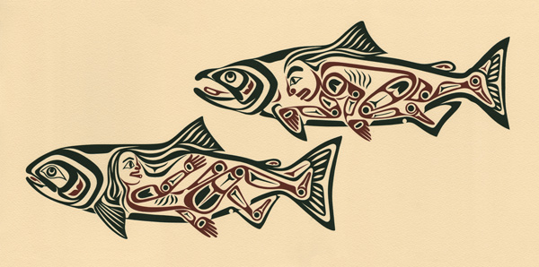
Salmon Legends in Indigenous Culture
Tri-State Steelheaders

Slide 2
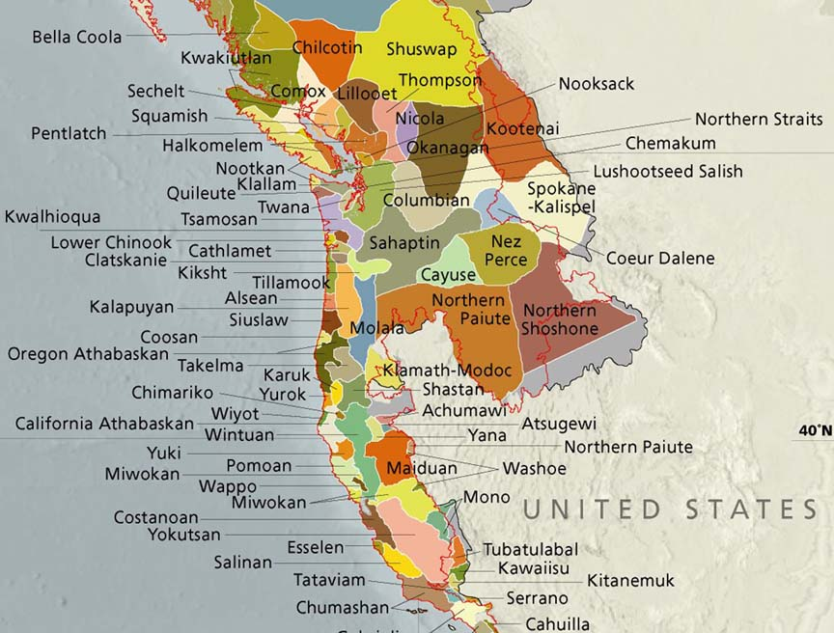
Tribes in the Pacific Northwest
The cultures of the Indigenous peoples of the Pacific Northwest have evolved alongside Pacific Salmon.
Salmon are a large part of Indigenous art, legends, ceremonies and diet.

Slide 3
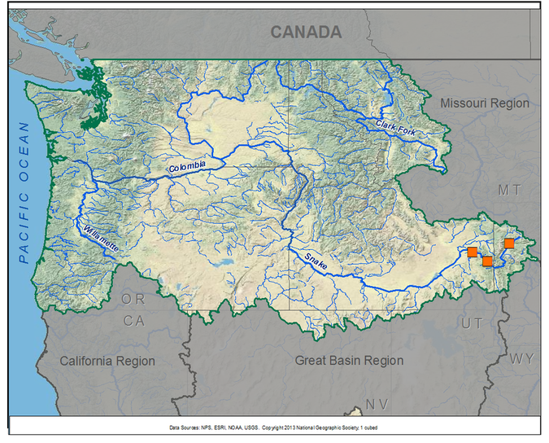
Salmon Legends
Let's go on a tour of just a few cultures salmon encounter on their way to and from their spawning grounds and learn a little from their legends!

Slide 4
Celilo Falls

Slide 5
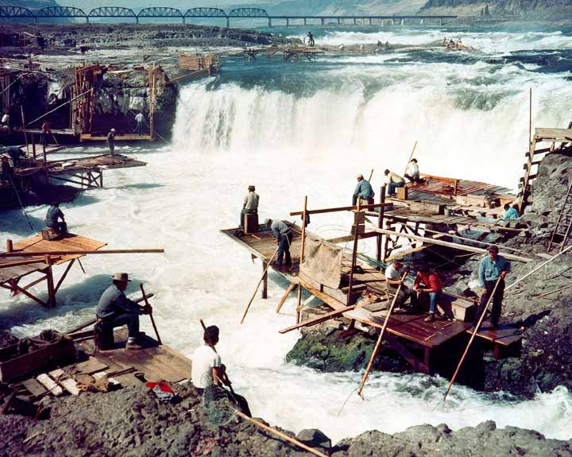
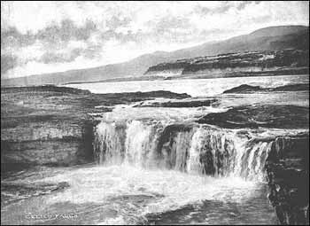
Celilo Falls - Nez Perce
Celilo Falls, a series of falls and rapids on the Columbia River, was a culturally important site to many tribes near the Columbia, who gathered there annually to fish, trade, socialize and perform ceremonies . The opening of the Dalles Dam in 1957 destroyed Celilo forever.

Slide 6
Yakima

Slide 7
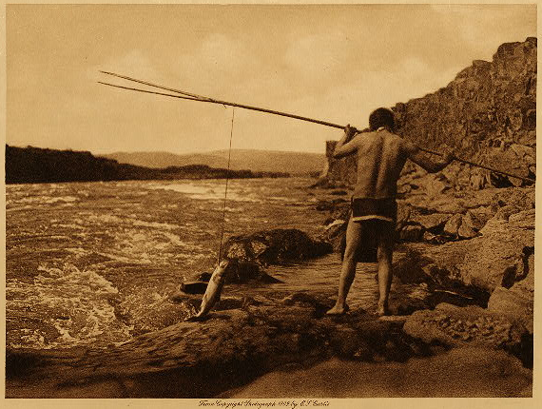
Legend of the Lost Salmon - Yakima Legend
The creator taught the people to care for the salmon, he said “Do not neglect this food. Be careful that you do not break the rules in taking care of this salmon. Do not take more than you need”
At first the people followed these rules, living happily. All along the river were bands of people catching and drying fish.
Then one day the people became careless and became greedy. They no longer cared for the salmon, they let them go to waste.
Suddenly the salmon disappeared.

Slide 8
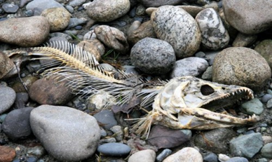
Legend of the Lost Salmon - Yakima Legend
People began to go hungry and search the rivers for salmon. Only to find one dead salmon.
It was said that stepping over the a dead creature 5 times would bring it back to life. However, every person tried and failed.
Excpt one. Old Man Rattlesnake.

Slide 9
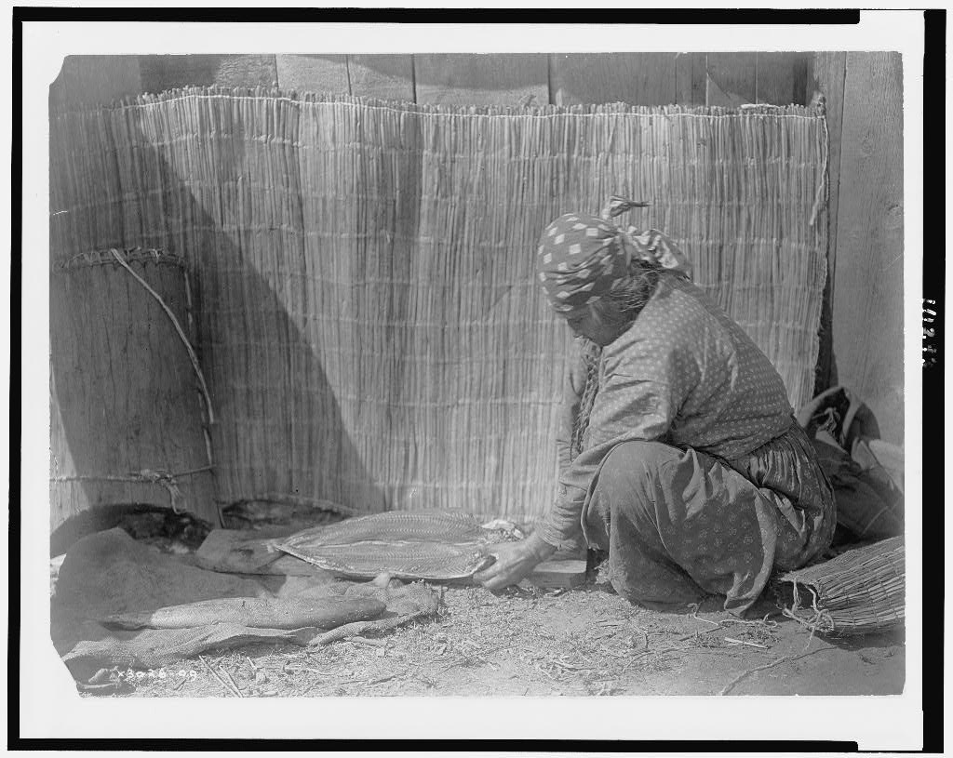
Legend of the Lost Salmon - Yakima Legend
The fifth time Old Man Rattlesnake stepped over the salmon, he disappeared into the salmon and the salmon came back to life.
Today when you catch a salmon and find a white membrane inside its spine, that is Old Man Rattlesnake who gave life back to the salmon.

Slide 10
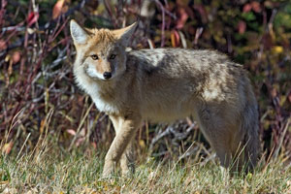
Deep Waters (Tsi Laan) - Yakima Legend
There was a time when Coyote told the other creatures they would be reduced in power, there were others that were coming and would rule over them all. The people with two legs.
So he began to prepare. He came up the Columbia River to the Chelan river and asked the Five Sisters what he should do. They told him to fix the river because there were no salmon

Slide 11
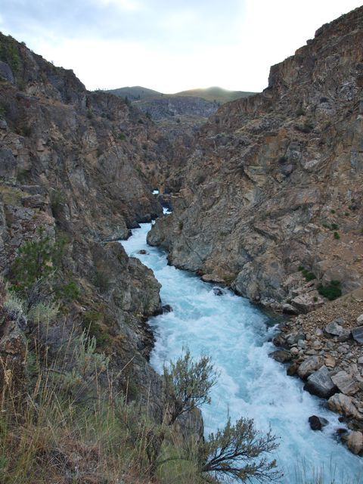
Deep Waters (Tsi Laan) - Yakima Legend
Coyote built steps with rocks, widened a narrow gorge, made deeper pools, created rapids from mud flats and fixed streams for the salmon to spawn. All for the people.
But when he asked the people if he could marry a pretty girl in return, he was denied. For the people felt they didn't need the salmon, they had enough food.
Coyote was angry and destroyed all of his work.

Slide 12
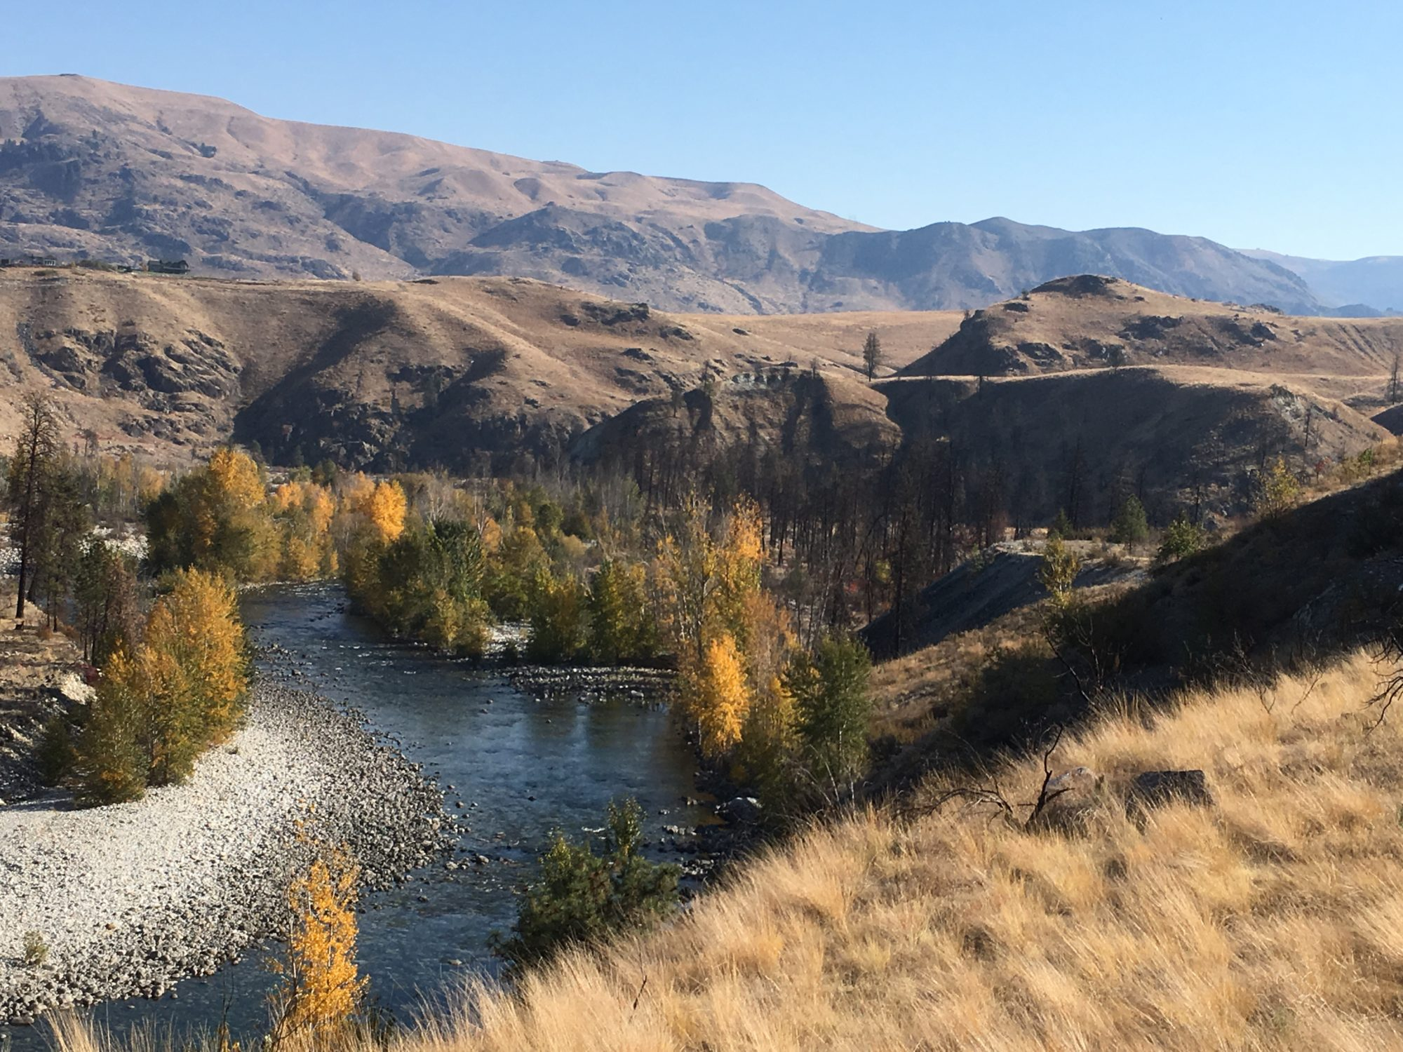
Deep Waters (Tsi Laan) - Yakima Legend
When Coyote was finished destroying the fishing sites he left his canoe in the river and turned it to stone.
Coyote said “the lakes can have only small fish now” and this is why many places in North Central Washington are without Salmon.

Slide 13
Squamish Tribes

Slide 14
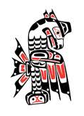
Why the Salmon Come to the Squamish Waters -
Squamish Legend
Long ago when animals and human beings were the same, there were Four Brothers who went about doing good.
The Four Brothers stayed a while with the Suquamish tribe. The chief, knowing the powers of the brothers, asked “Won’t you bring the salmon people to our shores? We are often short of food. We know that salmon is good, but they never come to our waters”

Slide 15
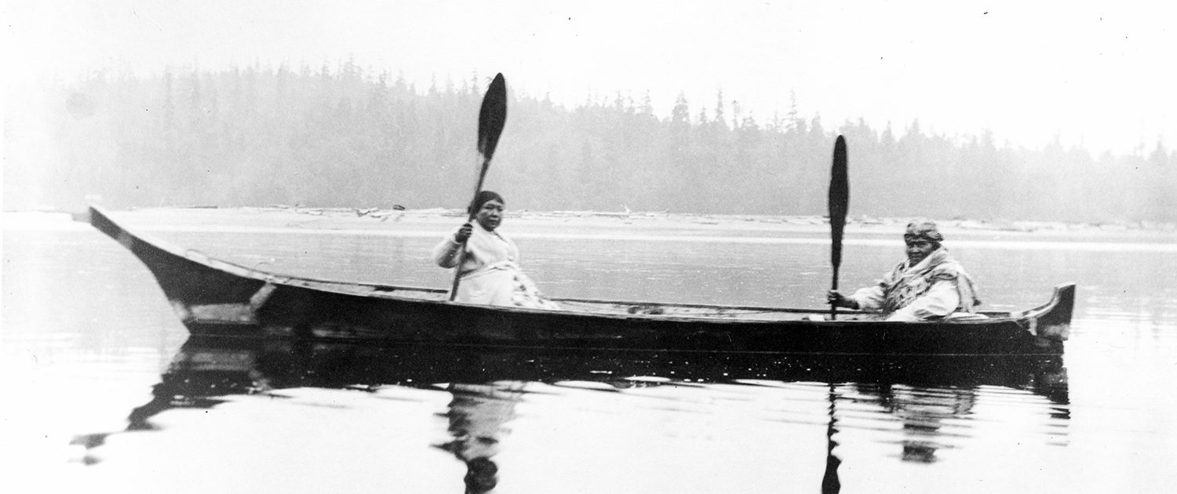
Why the Salmon Come to the Squamish Waters
Squamish Legend
After asking Snookum (the sun) the brothers knew to go west, prepare for a long journey and bring medicine.
After paddling for many days they came to an island with smoke rising in many colors, the sun told them this was the home of the salmon people.

Slide 16
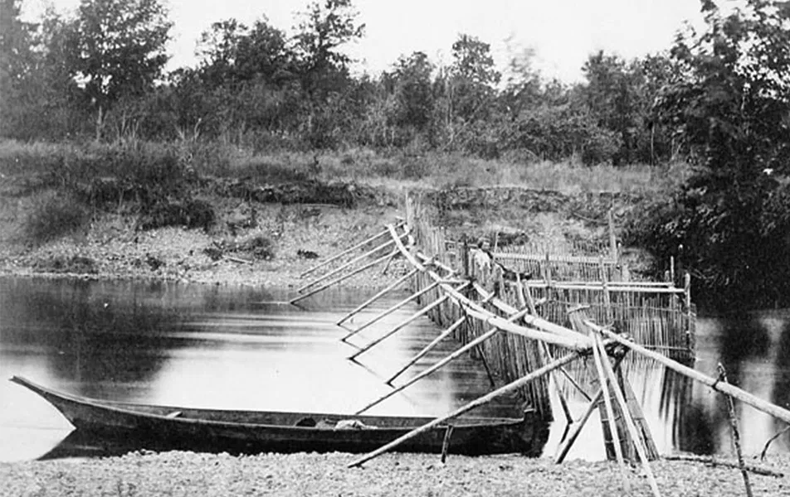
Why the Salmon Come to the Squamish Waters
Squamish Legend
Shortly before the visitors had landed, the chief had directed four of his young people to swim into the trap. The four drew their blankets over their heads and walked into the sea, turning into salmon.
These salmon were then taken from the trap when the people were ready to feast.
The salmon were cooked and served.

Slide 17
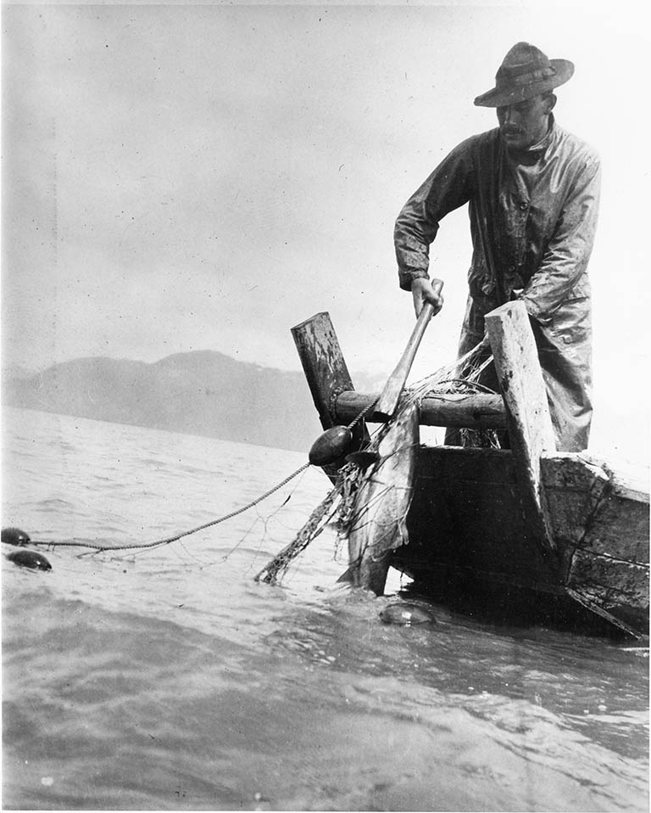
Why the Salmon Come to the Squamish Waters
Squamish Legend
The Chief told the guests to “eat all you wish, but do not throw away any of the bones. Be sure to lay them aside carefully.”
The Salmon people then collected the bones and threw them into the sea. The four young people from before returned from the water.
The fourth night a curious visitor secretly kept some of the bones. Once the rest were thrown into the sea the salmon people emerged, yet one emerged without bones for cheek bones or a nose.

Slide 18
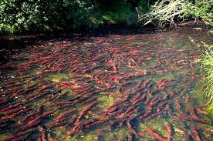
Why the Salmon Come to the Squamish Waters
Squamish Legend
The visitor gave the people the bones and was now sure they had found the Salmon People.
The Squamish Chief says “we have come to visit you, We came to ask you to let some of your Salmon People visit Squamish water”
The Salmon Chief agreed, so long as the bones are always returned to the water.

Slide 19
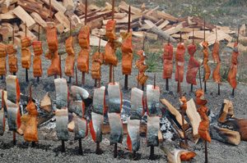
Why the Salmon Come to the Squamish Waters
Squamish Legend
The chief says “I will send spring salmon to you first in the season. After them I will send the Sockeye, then Coho, Dog-salmon and last Humpback”
Ever since, salmon have visited the Saquamish, and they were always sure to return the bones to the water.

Slide 20
Salishan Tribes

Slide 21
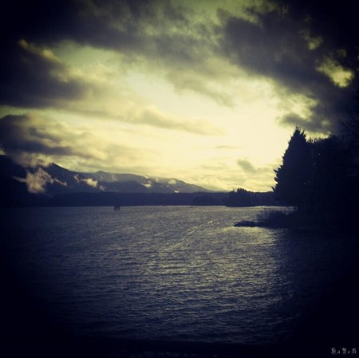
Coyote and the Columbia - Sahaptin and Salishan Tribes
One day Coyote was walking along and felt very hot. He said “I would like a cloud” and when it came along it was not enough. He then asked for more, it was not enough. He then asked for rain, it was not enough. He then asked for a creek, and then asked for it to be deeper.
It then became a huge swirling river and swept him away. Coyote nearly drown.
This is how the Columbia River began.

Slide 22
Clackamas Chinook Tribe

Slide 23
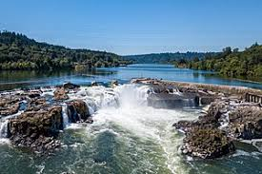
Coyote Builds Willamette Falls - Clackamas Chinook Legend
Coyote came to a place and found the people hungry. The river was full of salmon, but the people had no way to spear the salmon in the deep water. He decided to build a waterfall there to make the salmon come to the surface, and he decided to build a fish trap there as well.

Slide 24
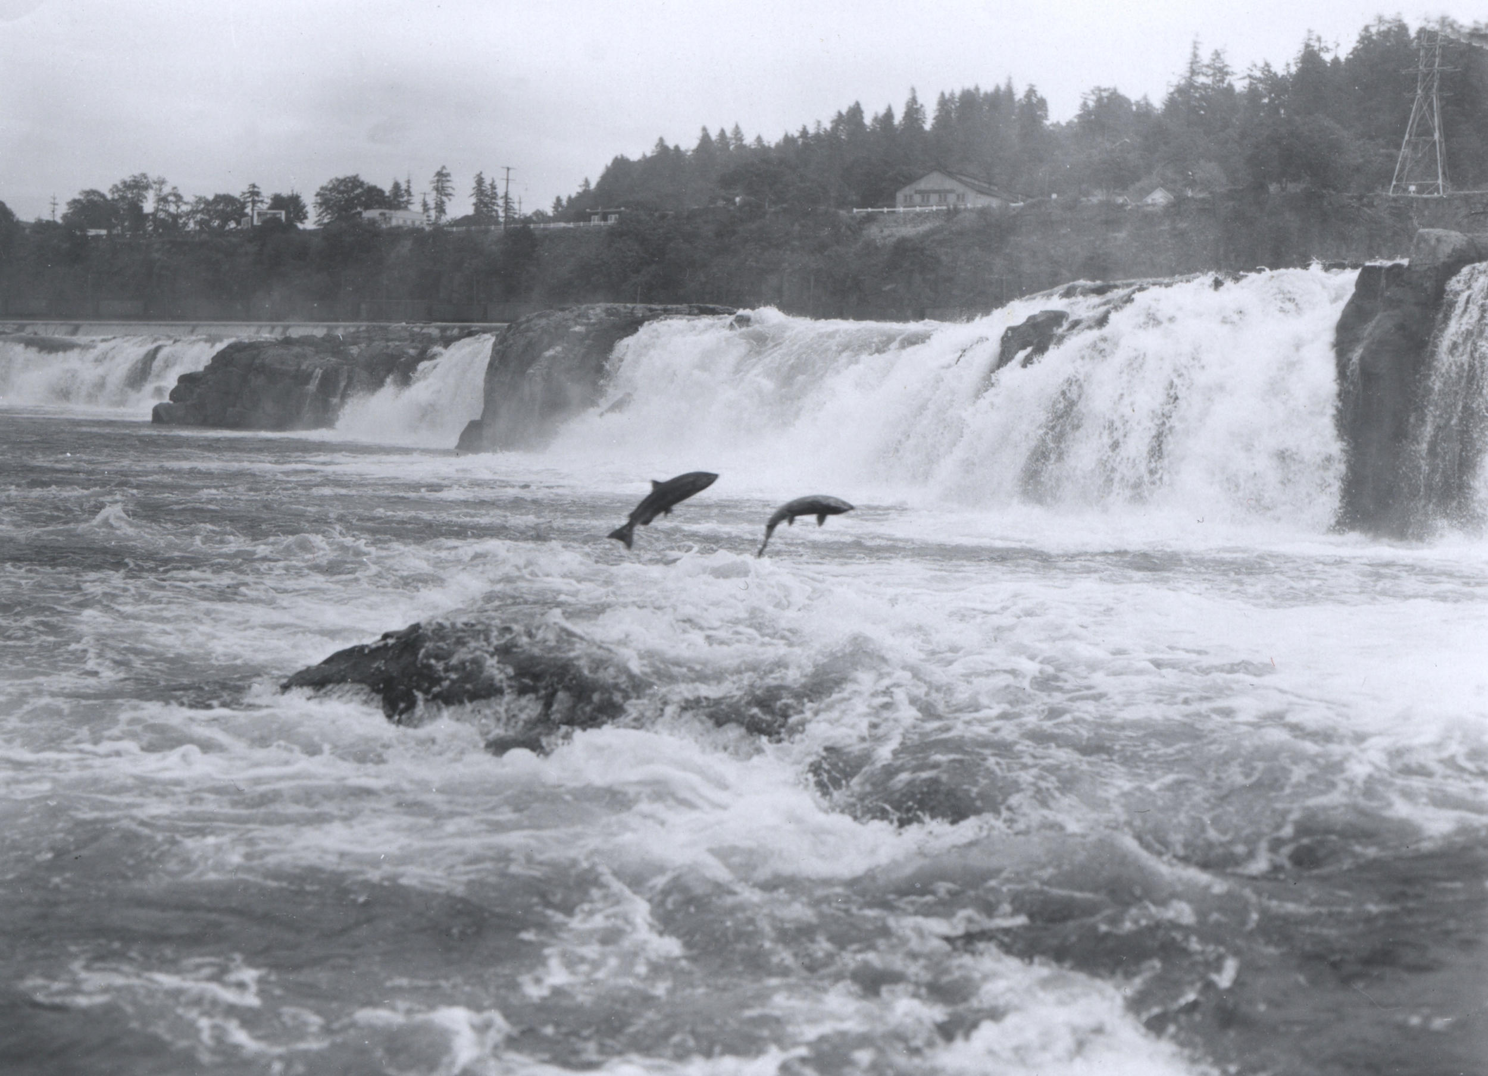
Coyote Builds Willamette Falls - Clackamas Chinook Legend
Coyote tried to create a waterfall in many places but failed, and in the process created gravel bars and rapids.
He then came to where the falls are today and made a waterfall far and wide.
Coyote then built a magical trap that spoke when it was full. It would say “Noseepsk!”

Slide 25
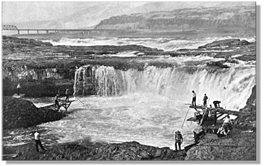
Coyote Builds Willamette Falls - Clackamas Chinook Legend
The trap worked well, so well that Coyote couldn't make it back to the fire with the salmon before it was full again. This annoyed him and he yelled at it. This offended the magical trap so it stopped working.
Now the people have to use only spears to fish in Willamette Falls.

Slide 26
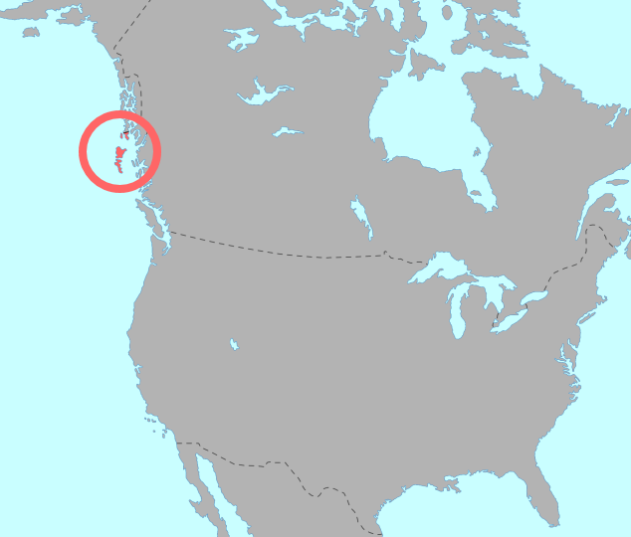
Haida Tribe

Slide 27
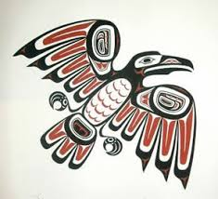
The Coming of the Salmon - Haida Legend
The little daughter of the chief cried and cried, for her father could not give her what she wanted. She dreamed of a great big shining fish. The chief ordered a great council fire and asked the tribesmen for help.
The wisest of the medicine man rose and told them his friend, the Raven, knows many things and may be able to help. He went to get his good friend Raven, who then told the council the little girl dreamt of a Salmon. He explained that the salmon are now living at the mouth of the river and he would fly and and bring a salmon representative to the village

Slide 28
The Coming of the Salmon - Haida Legend
The Raven flew above the salmon and caught the son of the Salmon Chief in his talons, and started towards the village. The salmon saw this happen and a horde of salmon, led by the chief, swam in pursuit.
The Raven gave the little girl the fish and she was very happy. He then told the chief many salmon would come to their inlet in pursuit of this one, and they were to create a net to catch them.
The people strung the salmon they caught up using a tethering pole.
Today the people honor the raven and the salmon in a totem pole that is used to string up the salmon

Slide 29
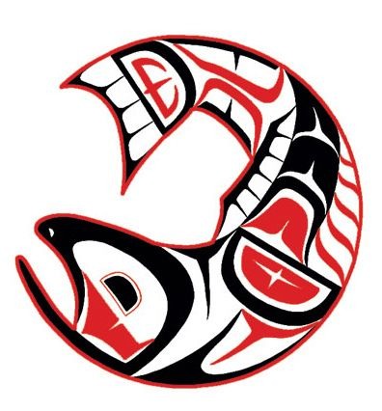
What did we learn?
Think about these stories that have been passed down in these cultures, what can we learn from them?
There are some more obvious themes warning against overfishing and respecting salmon.
But there are some more hidden themes, detailing the type of river habitat salmon need, as well as the nutrients that are held in a salmon and its importance in the river ecosystem.
What meanings did you find?

